Slide 1
Keeping the lights on: the case for an energy social tariff
David Southgate
Age UK
policy@ageuk.org.uk

Slide 2
What older people (60+) want to see from Government

Slide 3
Discount bills by 50% for eligible households
Target those in greatest need both on and off the benefits system
Automatically enrol eligible households
Be universal across suppliers
Sit alongside existing consumer protections
Support all eligible domestic consumers (e.g. fixed tariffs, alternative fuels)
Principles of the social tariff

Slide 4
Recipients of means tested benefits, disability benefits, or Carer’s Allowance. (eligibility criteria 1).
+ all those living in relative poverty (equivalised after-tax household income below 60% of median after-tax income. (Eligibility criteria 2).
+ all those living just above the poverty line (equivalised after-tax household income below 70% of median after-tax income).
(Eligibility criteria 3).
Our Proposed Eligibility Criteria

Slide 5
Why data matching and auto-enrolment matters

Slide 6
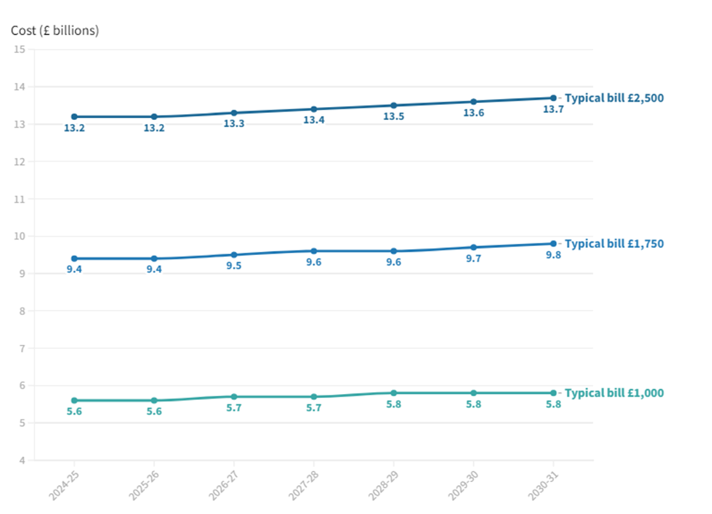
Cost
Notes:
£10.8bn is the latest estimate if the gov fund it (if it was a 50% tariff).

Slide 7
Tariff discount | Annual cost to customers missing out (cap at £2,100, based on eligibility criteria 3).
50% discount | £620
30% discount | £370
10% discount | £120
Why government funding matters

Slide 8
Addressing the energy inefficiency penalty (unit rate discount)

Slide 9
The Government’s target of reaching net zero greenhouse gas emissions by 2050 is incredibly important.
A just transition to net zero is only possible if vulnerable households of all ages can keep their heating on and access improved household thermal efficiency.
The energy social tariff and net zero are parallel workstreams in this regard – complementing one another in the fight to keep people warm and well.
Energy Company Obligation ECO+ funding will be key. Government should provide £1bn per annum and extend the scheme so it lasts at least five years.
The Home Upgrade Grant (HUG) scheme should also receive £1bn of funding per year every year until 2032, to ensure all eligible households have the opportunity to access it.
How do we get a net zero social tariff?

Slide 10
Age UK consumer policy team
policy@ageuk.org.uk
Report can be found at this link: https://bit.ly/3Fkdp0o

