Slide 1



The changing landscape for energy advice
Ian Preston and Katey Bell
cse.org.uk
@HelloCSE

Slide 2


The context
  The last three years have seen a dramatic change in the way we give advice and also what we give advice on.
  So, what’s happened?

Slide 3
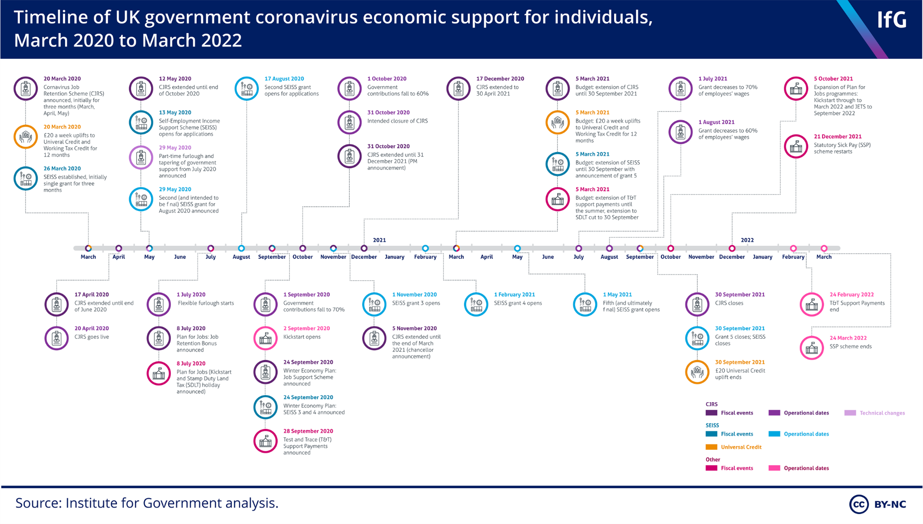
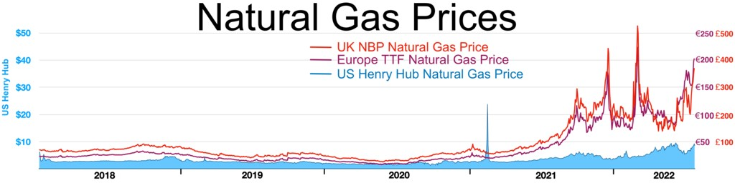

Slide 4
The context
  The global pandemic led to a huge societal, political and economic shock – we are still trying to understand this.
  The war in Ukraine and Putin’s preparation for this led to a global energy crisis (which is at its worst in Northern Europe)
  The economic impacts of Brexit have somewhat been masked by covid (but they do exist)
  The result… inflation, falling incomes, hyper fuel poverty
  Overall wellbeing is unsurprisingly still below pre-pandemic levels (ONS)
Notes:
Average ratings of personal well-being in the UK have improved across all indicators in the year ending March 2022; but remain below pre-coronavirus (COVID-19) pandemic levels (the year ending March 2019).

Slide 5
Demand ramped up during covid
  There was a 50% step change between 2019-20 and 2020-21
  Funders responded to the need during covid
  This led to a significant growth in the team (30 to 60)
  Due to our phone line being open we were the last person standing (for advice)
  We quickly repurposed teams to make wellbeing calls to the most vulnerable

Slide 6

How has our advice changed?
  The total numbers for each topic have grown. But some disproportionately.
  Financial support now dominates our advice and switching hardly features
  Heating, insulation and behavioural remain consistent
  New topics have emerged like smart energy action plans and EPCs (which relates to issues with the Warm Home Discount)
  It’s now very hard to give rounded advice because people are so driven to access short-term support

Slide 7
Advice topics
Notes:
EPC now 304

Slide 8
What about our interventions
  The government began a huge capital injection of funding into retrofit as part of the Green Homes Grant
  LADS, HUGS & SHDF have seen out financial impacts rocket to £7m this financial year
  We’ve also seen a huge growth in the numbers of advice conversation covering radiator panels, secondary glazing, solar PV and Winter Warmth Packs
  We’ve given out nearly £400k in vouchers (around £310k for fuel)
  We are working closely with food banks with one of our advisors working from them during lockdown
Notes:
Also shop at Waitrose and Sainsbury’s

Slide 9
But the reality is dire
“The cold is wrecking havoc on one of my neurological diseases. My nurse wanted me ideally have a room at constant 20 degrees. I cannot afford that when 15-18 is costing so much. I cannot use warm centres as cannot mix with people and I have severe fatigue and high doses of morphine I do not leave my flat unless hospital or GP.” (Respondent 5, Bath, no EPC)
“Mould and cold has increased illnesses. If it wasn't for Warm and Safe Wiltshire [CSE advice service] I would have died after losing my disability allowance.” (Respondent 2, Swindon, no EPC)

Slide 10
Trust in the market is getting worse
  At the end of 2022 the media ran several stories about forced installations of ppm meters & remote switching to prepay
  Trust in the market is still very low compared to 18 months ago (Which - net balance of -23 compared to +23 in May 2021)
  We need consumer trust to be increasing!
  Smart meter roll out sits at 57% of homes (NAO)
  Of the remaining 43%... 41% had concerns about them
  The DNOs need to care more about supplier behaviour and market trust
Notes:
https://www.which.co.uk/policy-and-insight/article/consumer-trust-in-november-2022-afK0E5z9FDI7

Slide 11
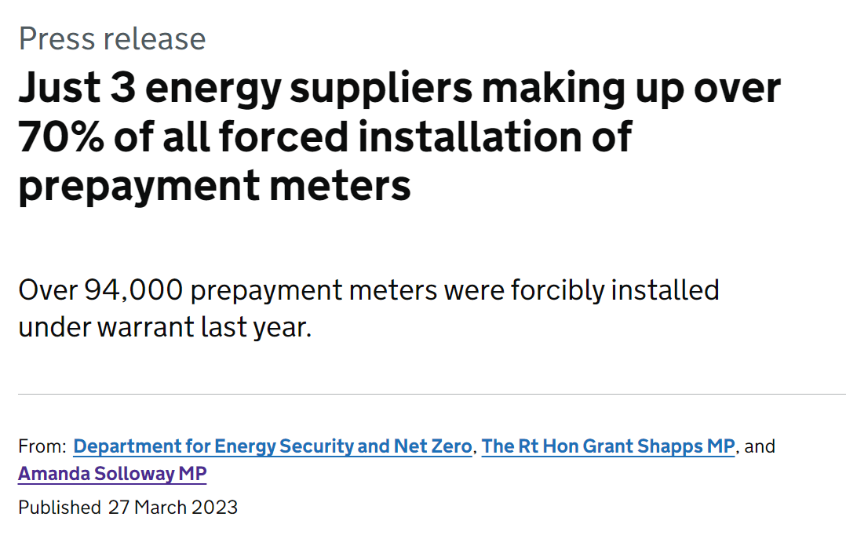
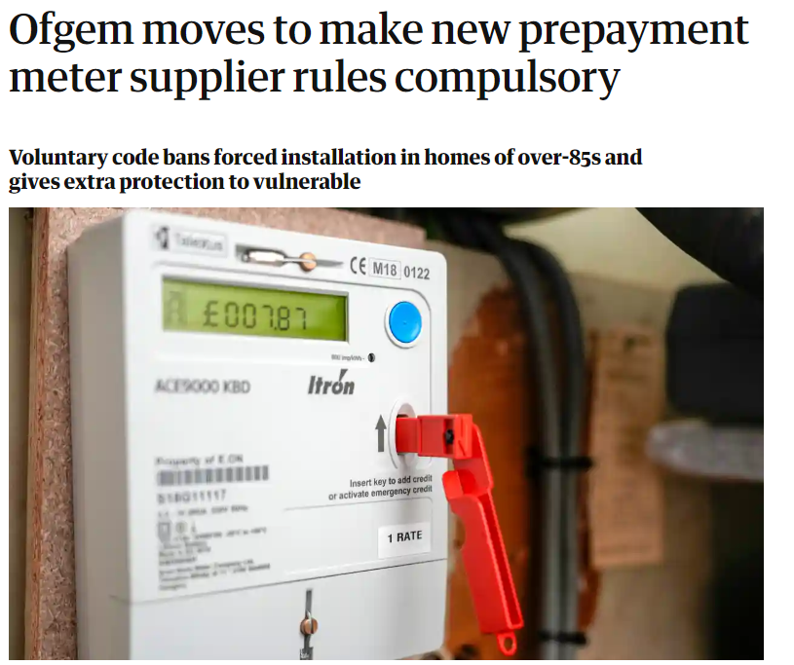
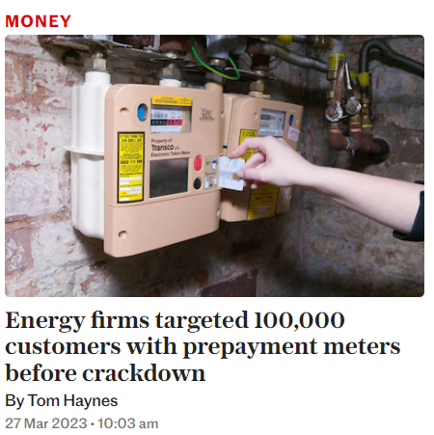
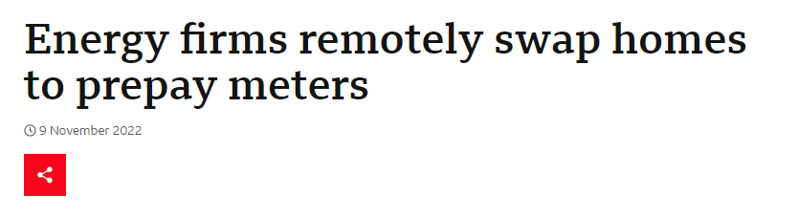
Notes:
Leading the charge with the highest number of prepayment meters force-fitted last year are British Gas, Scottish Power and OVO Energy.

Slide 12
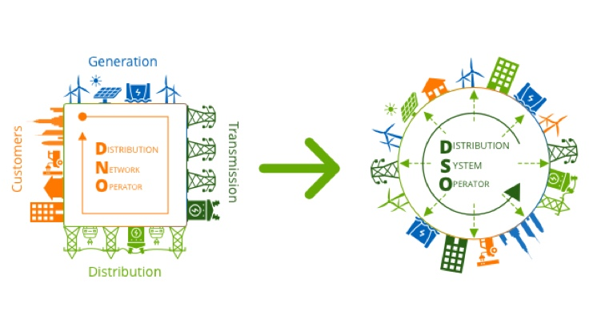
This part won’t work very well

Slide 13
Working in the advice team
  Before Covid we were a smaller team, sitting together in a section of the office. New staff were surrounded by colleagues and managers.
  During the pandemic as an essential service we had to develop new ways of working to onboard and train new staff. A core team and new starters came in.
  Growth is a cost to an organisation
  We now have to work hybrid due to the space available. We have adapted to new ways of working in order to replicate the supportive learning environment.
  Mentoring, casework supervision and online training, bespoke call handling training, lunch clubs for advisors and caseworkers

Slide 14
It’s really tough our there
  Burn out is a significant risk for many working in the advice sector
  Advisors are impacted by clients in mental distress who are in awfully difficult situations
  Many callers aren’t willing or able to engage with longer-term advice
  Our case work projects are over-subscribed and waiting lists are huge on some projects
  We still waste days of valuable staff time just trying to contact suppliers and gain authority on their account. The forthcoming consumer standards consultation is an opportunity to address the latter
  Giving people a voice: staff surveys (CSE wide as well as training needs, lunch club suggestions, difficult calls), advisor reflective sessions, employee voice
  Emotional support: Mental Health First Aiders, Lifeworks, Time Out
  Work-life balance: staff yoga sessions, social events, including board game evenings in the office
  Activity balance and staff development: ensuring that we develop opportunities to fit the interests and skills of our staff, giving everyone a balance of different types of work

Slide 15
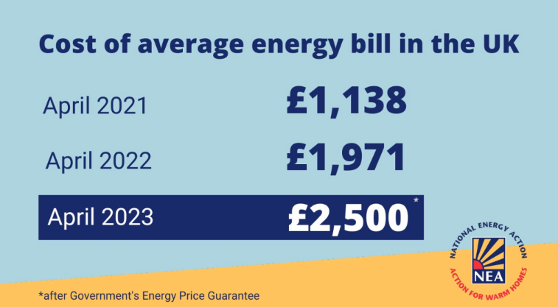
Let’s not forget
  Bills were still double the level in 2021 (even with the full intervention of Government)
  The July 2023 price cap of £2,074 has not taken us anywhere near pre-crisis levels

