Slide 1
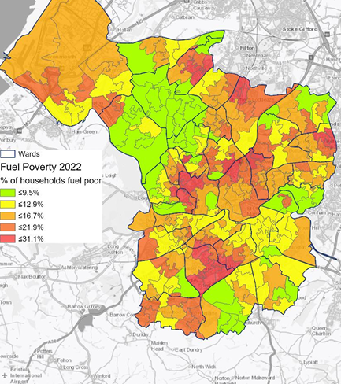
Bristol Fuel Poverty Action Plan
Challenges of networking support across a city
Karen Smith
ESAN meeting 03.07.23
Percentage of households in Fuel Poverty in Bristol by LSOA (based on Low Income Low Energy Efficiency (LILEE) metric) Source: Department for Business, Energy and Industrial Strategy (BEIS), 2022. Annual Fuel Poverty Statistics Report 2022 (2020 Data). www.bristol.gov.uk/jsna

Slide 2
Bristol’s Fuel Poverty Action Plan
Drafted 2018, adopted April 2022.
Why? Lasting negative impacts of living in a cold home on physical and mental health and community wellbeing.
How? Cross-sector collaboration to support Bristol residents to live in a warm and comfortable home.
What?
Support for the acute and immediate need of people in fuel poverty or who can’t afford fuel bills.
Long-term preventative approach e.g. energy efficiency, heat decarbonisation, new homes.
Tackle fuel poverty via national policy intervention.

Slide 3
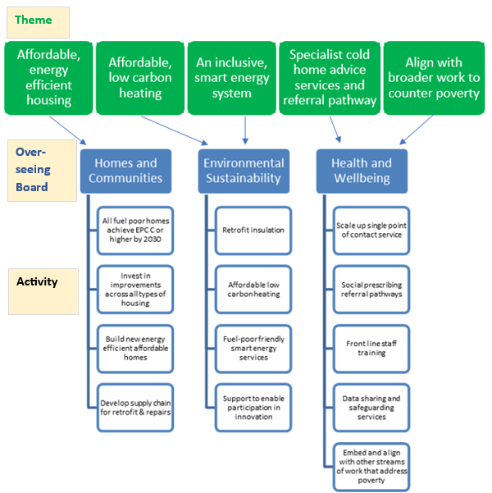
Plan overview and steering group
Fuel Poverty Action Plan has five themes
No Cold Homes steering group, cross-sector partnership
Steering group coordination by CSE for 2023
Quarterly meetings
Annual progress review of the plan
Strategic support at national / regional / local levels
Notes:
No Cold Homes steering group works to (1) identify opportunities to reduce households in fuel poverty; (2) improve properties to ensure healthy, warm, carbon neutral homes.
Unblock challenges in the system related to fuel poverty.
Bring together partners cross-sector to tackle fuel poverty.
Support the strategic development of fuel poverty policy and practice.
Inform One City Thematic Boards e.g. provide expertise.
Ensure activities involve people with experience of fuel poverty and link to wider health services.

Slide 4
Progress review 2022-2023: key points
Increase in fuel poverty by 2.6% since 2017 (2021 data), 29,000 households.
Advice sector in emergency response mode, proactive interventions (hospital discharge, warmth safeguarding) deprioritised.
Low progress on engaging with private landlords.
Good progress on securing funding for energy efficiency, heat decarbonisation and advice services
Some progress on Cold Homes awareness training with health services and referral pathways
Notes:
Increase in fuel poverty by 2.6% since 2017 (2021 data), up by 6000 to 29,000 households.
Bristol quality of life indicators for state of home repair, ability to manage financially, food inequality and mental wellbeing have all statistically got worse.
Demand for energy advice has spiralled, as reported by advice providers across the board.
MEES – no target for EPC D by 2025 or C by 2030, was being reviewed
£947k est. financial savings to Bristol residents from advice services
Good progress on securing funding for energy efficiency, heat decarbonisation and advice services (£6.97m for domestic energy efficiency improvements; £9.1m SHDF; £579k for advice services)
Low progress on engaging with private landlords - Dfficulties of encouraging private landlords and agents to invest in energy savings measures due to increasing cost pressures on their businesses such as mortgage rate increases and a lack of accommodation supply enabling low EPC accommodation to be relet easily. Tenant retaliatory evictions, MEES regulations no date for D and C implementation

Slide 5
Challenges of networking support across a city
Staff turnover, significant restructuring in local authority and health service.
Overwhelm!
Fragmented, inconsistent advice service funding.
Difficulties with data linkage to target patients with cold-related illnesses (NICE guidance)
Bristol Health Service Info Governance - No to EPC or postcode level data.
Proxy work rounds. Simple method so health practices can prioritise patients.
Previous trials abound: Leeds, Devon, Somerset.
ECOFlex includes referral mechanism for health professionals!
NB: Beware of heat decarbonisation exacerbating fuel poverty due to imbalance in cost of gas and electricity.
Notes:
CCC report 280623 highlighted importance of reducing the comparative cost of electricity to gas to encourage heat decarbonisation.

Slide 6
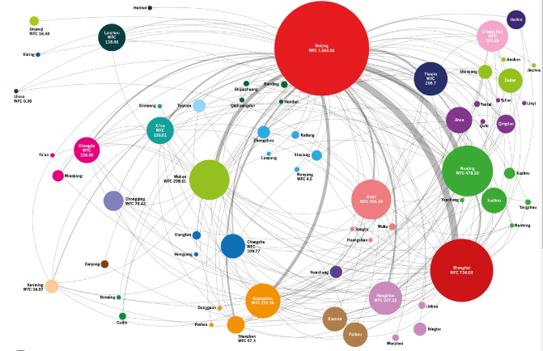
Questions
What would be your top tip for facilitating a network / partnership?
How do you manage levels of collaboration for community input?
Any questions, suggestions, comments
Karen Smith (CSE) karen.smith@cse.org.uk

