Slide 1



The Extra Help Unit – insights into affordability and prepayment meters
Natasha Gilmour – Head of Operational Support at CAS
&
Angus McMillan – EHU Performance & insights Manager

Slide 2
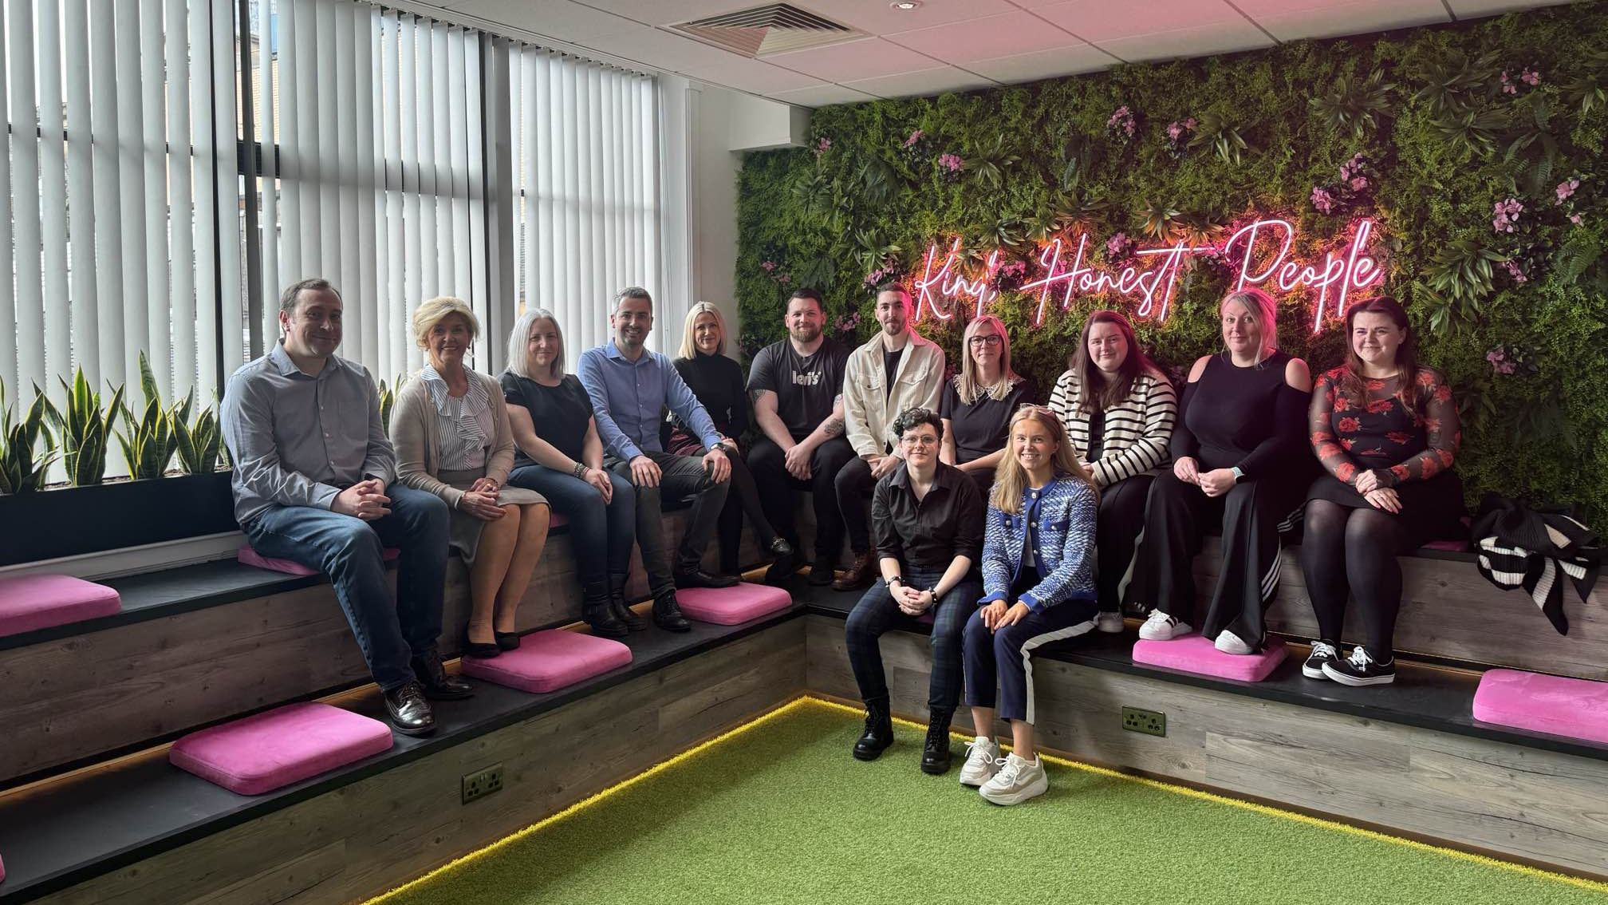

Slide 3



What is the EHU?
The EHU was set up in October 2008 to assist vulnerable domestic and micro-business energy and postal consumers across GB.
In April 2014 management of the EHU passed from Consumer Futures to Citizens Advice Scotland.

Slide 4

What are the EHU’s statutory powers?
Powers and duties set within CEAR Act 2007:
Section 12 – powers to investigate complaints on behalf of vulnerable people who need extra support
Section 13 – duty to investigate those disconnected or at risk of disconnection
Referral Only Service
Second tier, specialist support – main referral partners are CitA Consumer Service (England and Wales), Advice Direct Scotland. Also, Ombudsman Services and Ofgem.
Section 14 – duty to identify and refer compliance concerns to the regulator regarding section 12 and section 13 complaints
Section 8 of the Complaint Handling Standards 2008 obliges licenced energy companies to have suitable arrangements in place with the Extra Help Unit to resolve section 12 and 13 complaints in an appropriate and timely manner.

Slide 5

How we define vulnerability?
A consumer is vulnerable if they are unable to resolve a complaint or enquiry without additional support.
Vulnerability can be transient – it’s important not to make assumptions
This could be due to one or even multiple barriers:
Personal circumstances
Medical concerns
Complexity
Urgency of situation
Notes:
Importance of transient nature of vulnerability (potential to exclude people by making assumptions and categorising people). Foundation of our communication around vulnerability – not tick box exercise.

Slide 6
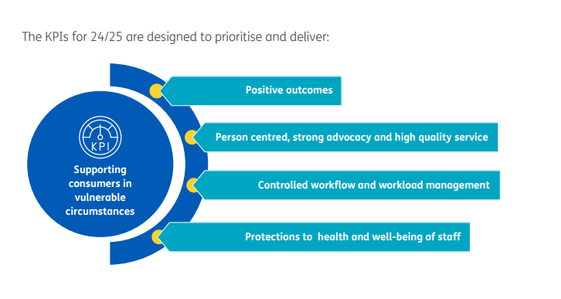
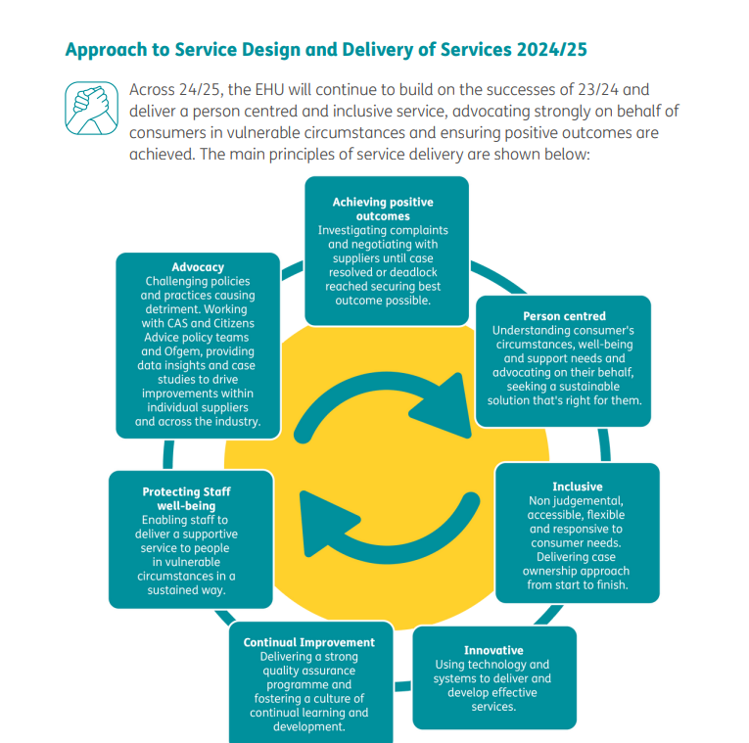
Service Delivery Model
Responding to priority complaints | 95% of priority complaints are raised with supplier within 48 hours of being received
Responding to complex complaints | 90% of complex complaints raised with supplier within 15 days of being received
Case resolution timescales for domestic complex complaints | 80% of domestic complex complaints resolved within 85 days
Case resolution timescales for priority complaints | 75% of domestic priority complaints resolved within 28 days
Quality Assurance | 90% of cases checked meeting required quality standards
Delivering Positive outcomes | 95% of domestic complaints resolved with a positive outcome/change
Staff morale and well-being | 75% of staff describing their current mental health and wellbeing as satisfactory 75% of staff reporting they have a good sense of achievement from the work they do

Slide 7


Demand 2023/24
The Extra Help Unit handled during 2023/24:
28,000 Priority Complaints
6,000 Complex Complaints
3,600 Enquiries
1,200 Ask the Adviser contacts
300 Additional Support referrals
78,000 incoming telephone calls
Financial Redress
Financial redress includes goodwill, reduction to account balances, guaranteed standards, payments and fuel vouchers. This is direct financial benefit of advice given, it does not take account of the indirect/preventative impact of positive outcomes delivered on other services and organisations budgets by achieving this financial redress.
Total redress for 2023/24 financial year = £6,168,962

Slide 8
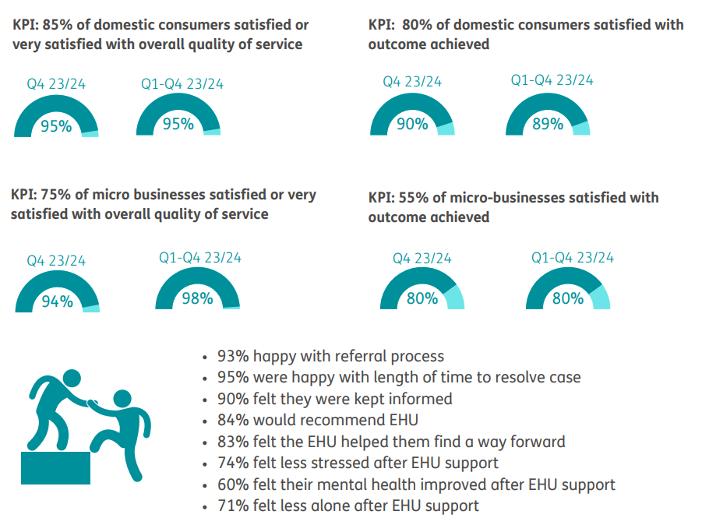
Customer Satisfaction Research
“I had no gas or electric left and was struggling and he was so helpful and helped me
keep warm and I didn’t know I could get such help so thank you.”
“I’ve never had help like it. It was bish bash bosh. It’s the most helpful anyone’s ever
been with me.”
Notes:
G

Slide 9

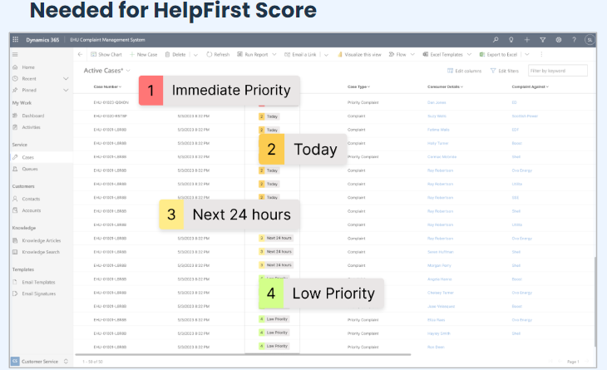
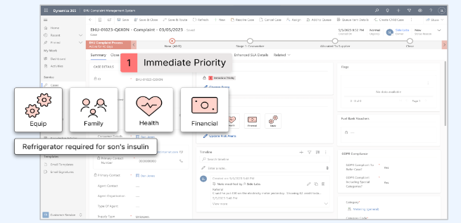
Operational Development
Building on implementation of new case management system - Microsoft Dynamics (D365)
EHU Supplier Portal Development – initial feedback in development. Planning for phase 2 to follow in Autumn.
CivTech
Scottish Government Tech Accelerator Programme that brings the public, private and third sectors together to build things that make people’s lives better. CivTech is designed to create digital solutions to public sector problems as quickly and effectively as possible
EHU Challenge: ‘How can technology help to quickly identify and prioritise support for people in the most vulnerable situations’ CivTech Challenge 8.1 — Identifying and prioritising support — CivTech
Working with HelpFirst to implement 2 main features using AI – HelpFirst Score and Risk Alerts

Slide 10
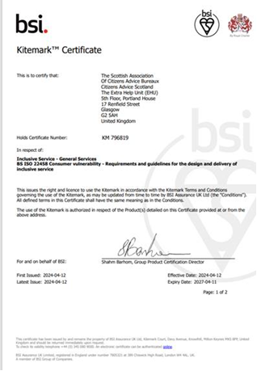

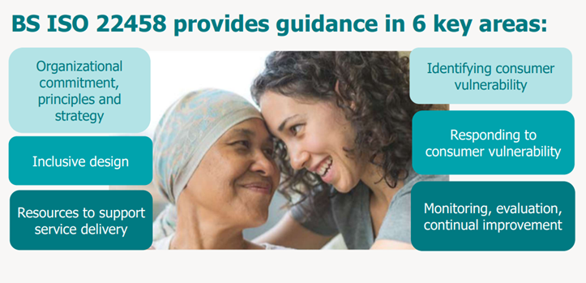
Development of Services
BS ISO22458 Kitemark certificate for Inclusive Service
The Extra Help Unit previously held the British Standard for inclusive service provision. In early 2024, following a further extensive audit process, we were successful in upgrading to the new ISO standard.
In practice it means that the service has been recognised as supporting vulnerable consumers in a flexible, accessible and inclusive way.

Slide 11
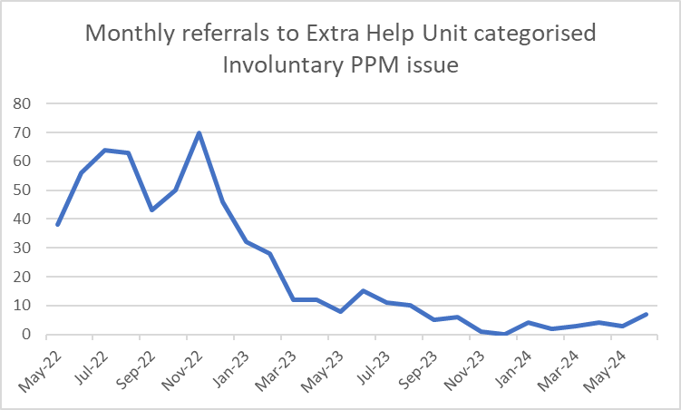
Involuntary installs – experience before the moratorium on forced PPM installs
Significant volumes of cases were received prior to Ofgem introducing the moratorium in January 2023
EHU raised concerns with Ofgem in Autumn 2022 about vulnerable consumers being forced on to Prepayment Meters or consumers being generally forced onto these meters due to billing and/or customer service errors.

Slide 12
Energy supplier attitudes
Suppliers effectively had two positions on involuntary prepayment:
That many consumers could afford to pay, but were refusing to do so, and would phone up and pay the balance owed before a PPM was actually fitted
That prepayment meters were a necessary budgeting tool allowing consumers to manage their energy use and costs better
While there may be a degree of truth to both these positions – the reality was often an overzealous approach in practice

Slide 13
Case study – poor engagement/opportunity to record vulnerability missed (Sept 22)
The consumer referred to the EHU due to her gas meter being changed to prepayment without her consent. There was a 2 year old and 12 year old living at the property. The consumer had anxiety, depression and bipolar disorder.
She was behind on her payments and contacted the supplier for support or a reduced payment plan, but was advised no help could be given. The consumer contacted Stepchange and was given advice, including to arrange for Breathing Space to be put in place, but the supplier failed to act on this.
An agent attended the property and knocked on the door. The consumer’s 12 year old daughter with several disabilities including autisim answered the door and informed the agent that her Mum was unwell in bed.
The agent then went back to the car and delivered a letter through the letterbox. The letter had a box ticked that the consumer had agreed to her gas meter being changed to prepayment mode, despite never speaking to her.
Following the EHU’s intervention the meters were switched back to credit mode.

Slide 14
Case study – supplier customer service error (Sept 22)
Consumer was recovering from a recent operation. She has severe arthritis and blood clots in her brain that affected her eyesight. She was of pensionable age and received Pension Credit.
Consumer was referred to the EHU as she has been off supply for electricity for six days due to the mode on her electricity meter being changed to prepayment on 31 August 2022.
It appears that the mode has been changed due to an issue with the account as the name on the account has been changed in error, with the supplier saying they are unable to speak with her as she's not named on the account.
The supplier confirmed that the name on account had been changed in error and the account showed as closed and so no payments were showing, this resulted in the mode change. The meter was returned to credit mode, failings acknowledged, and goodwill offered.
Important to note that this was a smart meter mode change case.

Slide 15
Other brief examples
The consumer was distressed by her financial situation had stopped opening mail sent to her – she lived with three young children in the flat. A referral was received into the Extra Help Unit because the consumer thought someone had entered her property and force fitted a PPM. Supplier confirmed a remote mode change had taken place two weeks earlier, following a site visit when they couldn’t gain access to the property.
Case referred to us as the household was off supply for gas, as both smart meters had been remotely changed to prepayment mode. There were 3 children at the property, and some of the children had disabilities, including a child with cerebral palsy. The property has a track hoist system powered via electric. The family also had to store medicine in the fridge. The reason the meters were switched to prepayment mode was because the account was in the consumers ex-partners name and the consumer unable to get a tenancy agreement in their name until court proceedings had completed.
Consumer of pensionable age with mobility issues, plus has a heart condition which requires use of an electrically powered machine. The consumer hadn’t made a payment for 3 years, but had been engaging with the supplier to request bank details so he could pay by standing order. Supplier admitted repeatedly failing to provide these.

Slide 16
Often relaxed attitude to the errors during this period
Yet another case involving the remote mode change to prepayment was a consumer who is 82 years old, blind, has hearing difficulties, diagnosed with COPD, is liable to trips and falls, and additionally had an emergency alert system which is hardwired and needs a constant supply of electricity to function.
In response to the case we were told that:
“we were only aware of x2 vulnerabilities before we carried out the mode change neither of which was deemed as unsuitable for Paygo. We've since added the additional x2 vulnerabilities to the customers account and PSR so that any review in the future we're fully aware of the customers situation.”
As we raised with the supplier and reported to Ofgem at the time:
“This highlights that that the supplier has failed to adequately identify and record crucial vulnerabilities, and it raises serious questions about the effectiveness of the process for identifing that a prepayment meter is safe and practical.”

Slide 17
Involuntary installs – what has changed?
Lower volumes at present - most supplier still in “trial mode”
Some signs certain suppliers pursuing alternatives to prepayment meters being fitted involuntarily – includes legal action and other debt recovery methods
New regulations and guidance from Ofgem offers benefits, but consumers in the most vulnerable situation will still struggle to effectively engage and highlight their vulnerabilities.
Significant risk of vulnerabilities being missed if remote mode change to prepayment occurs
Use of prepayment meters as a tool to address affordability is still problematic
£2,300 Average Energy Debt
Taken from Scottish Citizens Advice Bureau figures for 2023/24
34% of consumers in a negative budget situation have an energy debt

Slide 18

What will the Extra Help Unit be monitoring?
Checking that voluntary switches to prepayment meter have been properly assessed for suitability
Evidence from suppliers that processes have been followed
That opportunities to investigate disputed balances or other concerns have not been missed
That all opportunities to identify a household's vulnerabilities have been taken and judgements made on the suitability of prepayment meters in line with Ofgem’s regulations/guidance and the Precautionary Principle
That suitable after care has been provided, especially if it has become clear that a consumer cannot manage their prepayment meter

Slide 19

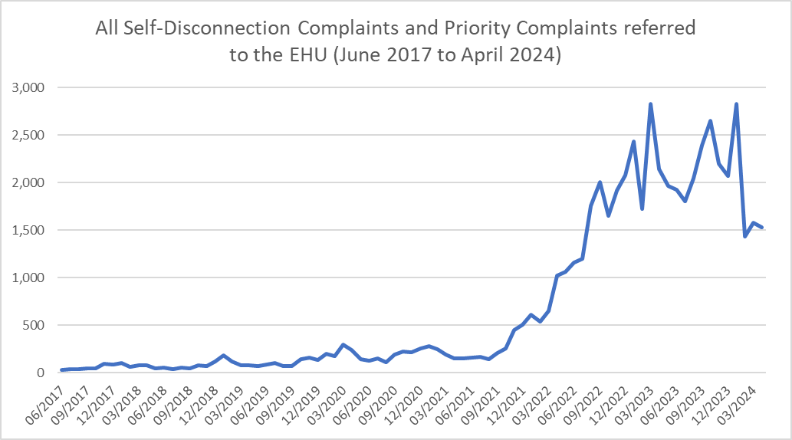

The other problem with prepayment meters:
Increased volume of self-disconnection cases
Volumes decreasing but still higher than historical levels

Slide 20

Consumer facing ongoing self-disconnection challenges
Additional Support Credit often required to support consumers through short term affordability concerns, but consumers in negative budget situations can become reliant on this to stay on supply
Many of these consumers struggle to engage with support services, or are already accessing all support available
Where consumers are reliant on Additional Support Credit, debt is accumulating on the account
Most suppliers recognising this and offering these consumers credit meters – however many prepayment consumers do not want a credit meter as they are worried about debt recovery action being taken against them.

Slide 21

Solutions
Broadly there is a need for two actions in the short to medium term:
Introduction of a social tariff to ensure the most vulnerable households can afford their ongoing energy costs
An expanded scheme to write off energy debts
Better funding of debt advice would also be helpful.
In the medium to longer term, improving the energy efficiency measures within fuel poor households across GB would also make a huge difference.

Slide 22
How can a person access the EHU?
If you live in England or Wales, you can get more help by:
calling the Citizens Advice consumer helpline free on 0808 223 1133, Monday to Friday, 9am to 5pm
submitting an online enquiry to the Citizens Advice consumer helpine
If you live in Scotland, you can get more help from:
calling Advice Direct Scotland on 0808 196 8660, Monday to Friday, 9am to 5pm
Ask the Adviser
The EHU also offers an Ask the Adviser Service to offer advice to other advisers trying to support their clients directly.
This is available Monday to Friday 9am to 5pm on 0344 980 0041
Please note this is not a referral line.

Slide 23
Questions?
Thank You!

