Slide 1

Energy Hardship:
Lived Experience Research
ESAN Members Meeting
17th October 2024

Slide 2
Purpose
In our Consumer Protection Programme for 2021 - 2024 we committed to:
A clear focus on debt
Research on consumer lived experiences of energy debt, self-disconnection and self-rationing
Using this research to inform discussion on how to improve supplier response and approach to debt
Aims
  Develop an in-depth understanding of the lived experiences of electricity and gas consumers who have struggled to pay for their energy and what they would find helpful.
  Provide evidence to inform the UR’s regulatory decisions to support domestic consumers who are struggling with or at risk of energy debt/affordability.
Method
Qualitative research into the
lived experience of electricity and gas consumers who have experienced energy hardship..
Lived experience - a first-hand account of a person’s experiences, perspectives and choices.
Interviews were held
November 23 – January 24
42 individuals took part
16 in-depth interviews
26 semi-structured questionnaires

Slide 3



Key findings
In many cases, a change in circumstances led to participants having to manage on a lower income….
“I ended up in intensive care on
life support. It's gone from two
incomes to one, so it's tight.”
“[My maternity allowance] ends in January, but the job that I was on before I got pregnant was temporary, so coming off maternity I'm currently unemployed.”
For others, their household energy needs had changed meaning they were using more electricity or gas….
Some were at home more often, as they no longer went out to work each day.
Some were families coping with more children in the home.
Others relied on medical equipment that used a lot of electricity.
Or had disabilities/illnesses that required their homes to be kept warm.
Overall, participants were reluctant to identify as vulnerable….
…and simply wanted to be able to get by on their current incomes
“I am in such a fortunate position compared to most.”

Slide 4
Key findings
To reduce their energy usage and save money, participants described some potentially harmful coping strategies.
Drastically cutting back on energy usage, in particular for heating, to levels below their essential daily living needs.
Skipping meals or reducing food intake.
Reducing use of hot water including for bathing and washing dishes in cold water.
Going outside the home for heat, either to family and friends, to community-based initiatives or to public spaces.
Parents prioritised their children’s needs, by skipping meals in order to feed their children and by only using the electricity or heating when the children would be at home.
“I had one meal yesterday. I'll probably have one meal today…”
“It's cold, but I'm not putting it on…you can't physically afford to put it on”
“We went to the swimming pool to get washed because we've had no gas.”
“It's my job to provide for my children.”

Slide 5

Key findings
ALL participants felt that their current circumstances had impacted their mental health.
Many felt anxious or embarrassed about asking for help and having to explain their situation.
“I have really bad anxiety. See, even the
thought…I'd feel like I was begging…
having to explain the situation, I would
just feel like a pity party.”
Others explained how they had sleepless nights, were taking anti-depressants and had feelings of hopelessness.
Some participants also noticed an impact on their physical health. This included:
The exacerbation of an existing illness or disability.
The development of new illnesses.
Respiratory issues such as asthma and problems with joints, participants felt this was due to a lack of warmth or because of damp and mould in the home.
Extreme weight loss or weight gain
“We tend to get sick very often…”
“You don't really see any way out…”
“I have asthma. If I get too much cold that affects me, I have to go to hospital. I have to heat my house.”

Slide 6
Key findings
Several participants felt they had little to no social life as a result of their financial situation…
…and viewed any spending above what they considered to be essentials as a ‘luxury spend’.
Examples where participants had significantly cut back included:
Activities and days out with their children.
Socialising with friends.
Going on dates.
Getting a haircut.
Having broadband or streaming services.
  “…silly things like excursions for my daughter, taking her to soft play it’s £7…[but] £7 could be us eating tonight.”
  “I was actually crying [thinking],
  ‘I can’t afford to live’ ”
  “I've got no money to put aside for essentials. Basically, everything gets spent on energy at the moment.”

Slide 7


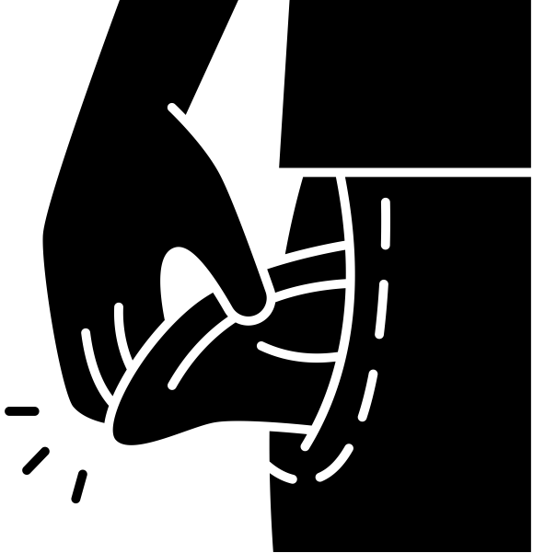
Key findings
Lack of engagement with suppliers
Most participants had not contacted their supplier about their situation.
Reliance on 3rd Party supports
Many of the participants had visited charities and advice services for support with managing their rising costs.
This included using services such as:
Food banks
Home heating oil support
Christmas support
Charity shops
Referral schemes
Many were unaware their
supplier could help or assumed
they wouldn’t.
Others felt anxious or embarrassed about explaining their situation to their supplier.
“The food banks are becoming the norm”
Some experienced difficulties
when attempting to contact
their supplier.
Many were reluctant to take on more debt that had to be paid back.
“It's my last port of call but I knew I had to”

Slide 8
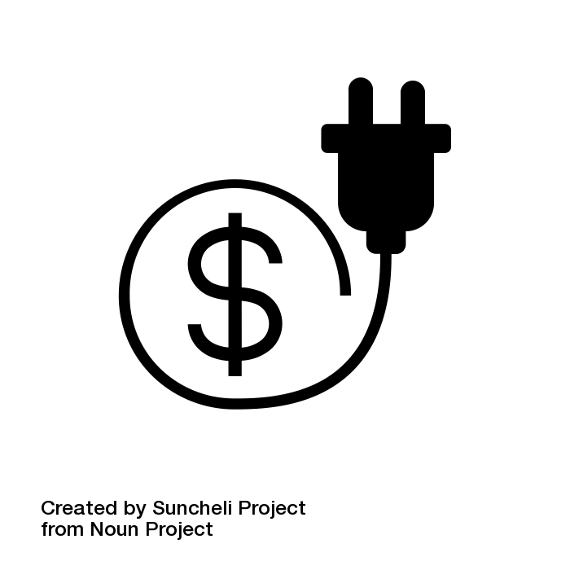


Key needs expressed by participants
Financial Support
Communication and Advice
Lower prices / Cap tariffs
to allow consumers to be
self-sufficient on their
own incomes.
Reduced tariffs for particular groups
such as young families, those with disabilities/illness in the household, those on low incomes and those on benefits.
Energy Advice
advice on energy efficiency practices, in particular to maximise heating systems.
Clear and transparent communication on tariffs
particularly for PPM users who want to understand their usage better.
Improved supplier communication
including supplier monitoring of energy usage and debt behaviours.
Increased awareness of existing supports
Suppliers, Government, Communities.
Government Support
Funded Community initiatives
such as warm banks.
Government funding
such as a winter energy payment or energy vouchers.

Slide 9
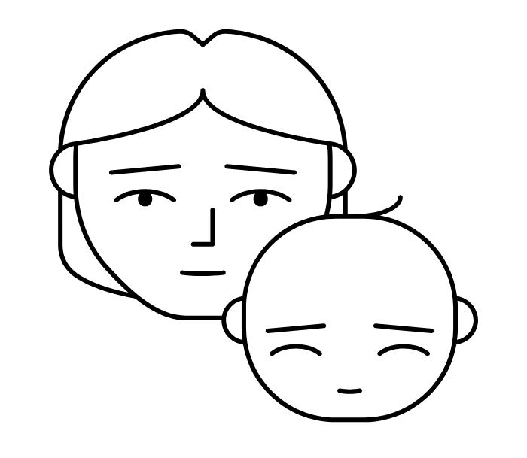
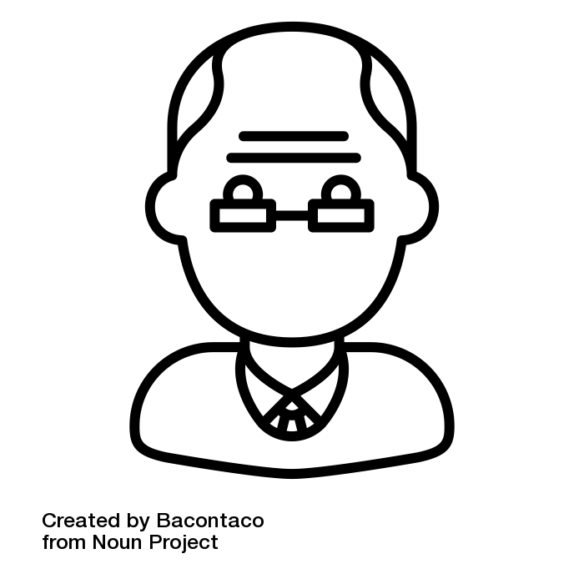
Case Studies & Quotes
Mr. T lives alone in public rented housing. He recently had to leave his job due to ill health and is struggling to understand the benefits system.
He has not used his gas heating for several years as he cannot afford to, and chooses to live in one room of his house to conserve electricity use.
Mr T.’s home doesn’t have a working cooker and he doesn’t own a washing machine or have internet. He rarely watches TV as he prefers to read. He has been severely rationing his eating and groceries to save money.
“I eat maybe a sandwich a day, a cup of soup or something…”
He struggles to understand tariffs and pricing, preferring to continue living as he does rather than get into debt with his provider.
“I’m trying to manage what I have at the minute without going, ‘Listen, I’m here with my begging bowl’”
“Now I've got a free bus pass. I sometimes just get on the bus. Because it's warm and just ride about”
Ms. E is a single mother who lives with her three young children in a private rented house.
She is unable to work as her son is disabled. This, along with a recent split from her children’s father, has left Ms. E with no money for most essentials and struggling to keep up with her bills and monthly expenses.
“I’m lucky that help is there, or we would be homeless.”
Ms. E. is aware that her electricity supplier can offer her support, however she has never contacted them due to feeling anxious.
“I have really bad anxiety…I’d feel like I was begging”
Ms. E. finds energy pricing confusing and wishes Suppliers would be more pro-active at ensuring customers are on the best tariff. She relies on Social Media for advice.
“it’s the changing, the up and down of the units...the prices...it makes it very difficult. Then you hear somebody else is only paying £20 on their electric a week…and you’re thinking how?”
“There were times I was worried how I was going to get grocery shopping […] Sometimes it was touch and go.”
Male, 60 – 69 years old
Female, 30 – 39 years old
“now I turn everything off.... I noticed quite a bit of difference… a £1 odd per week”
“I transferred 90p from my savings account into my current account so that I could top up on electricity. I thought to myself, this is a new low”
“It's not really living...You're just surviving on basic needs at the minute. And even at that, it's a struggle”

Slide 10
How we are using this research
UR Consumer Protection Programme
2024 to 2029 projects
Energy Hardship Engagement Group
Consumer Energy Charter
Energy Literacy Project
Review of supplier codes of practice
Engagement with
Government, industry and consumer representatives.
  For discussion
Examples of good practice or resources on:
    Effective communications with consumers who are in or at risk of debt.
    Building trust between consumers and essential services.
    Encouraging consumers to engage with their service provider.

